Slide 1


Intensive Course Biology for Technology Department of Agricultural Technology Faculty of Technology, University of Colombo by Dr. Aruna Kumara Udawasala

Slide 2
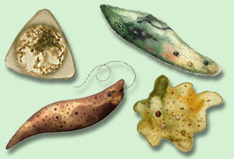
Kingdom Protista

Slide 3
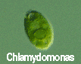
If you look at a drop of pond water under a microscope, all the "little creatures" you see swimming around are protists.

Slide 4
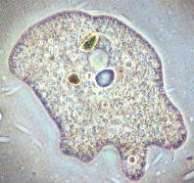
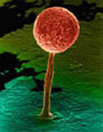
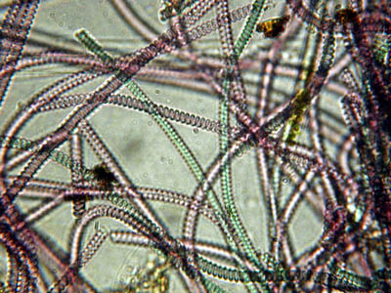
All protists have a nucleus and are therefore eukaryotic.
Protists are either plant-like, animal-like or fungus-like.

Slide 5
Plant-like protists are autotrophs – they contain chloroplasts and make their own food.
Animal-like and fungus-like protists and are heterotrophs.

Slide 6
Protozoans are animal-like protists (heterotrophs) grouped according to how they move.
The word protozoa means "little animal." They are so named because many species behave like tiny animals—specifically, they hunt and gather other microbes as food.

Slide 7
All protozoa digest their food in stomach-like compartments called vacuoles <vac-you-ohls>. As they chow down, they make and give off nitrogen, which is an element that plants and other higher creatures can use.
Protozoa range in size from 1/5,000 to 1/50 of an inch (5 to 500 µm) in diameter. They can be classified into three general groups based on how they move.

Slide 8
The first group is the phylum Rhizopoda. These are amoebae <ah-me-bee>, which can be subdivided into the testate amoebae, which have a shell-like covering, and the naked amoebae, which don't have this covering.
Amoebae ooze along by means of pseudopodia (false feet) engulfing food as they go.

Slide 9
Amoebae live in water or moist places.
They have a cell membrane but no cell wall.

Slide 10
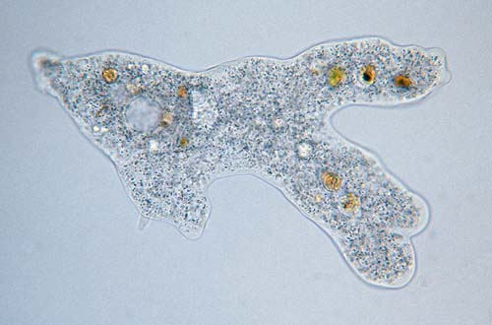

Slide 11
The second group is the Flagellates <flah-geh-lets>, of the phylum Zoomastigina. Flagellates are generally the smallest of the protozoa and have one or several long, whip-like projections called flagella poking out of their cells.
Flagellates use their flagella to move.
It is a flagellate in the intestines of termites which enable them to eat wood. Both organisms benefit…..what kind of relationship do they have?

Slide 12
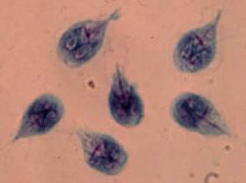
Giardia

Slide 13
The third group of protozoans are the ciliates from the phylum Ciliophora. These are generally the largest protozoa.
They are covered with hair-like projections called cilia and they eat the other two types of protozoa as well as bacteria.
Ciliates are found in every aquatic habitat.

Slide 14
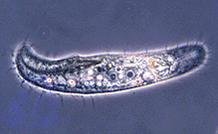

Slide 15
The last of the Protozoans come from the phylum, Sporozoa.
These are parasitic and nonmotile.
For example……

Slide 16
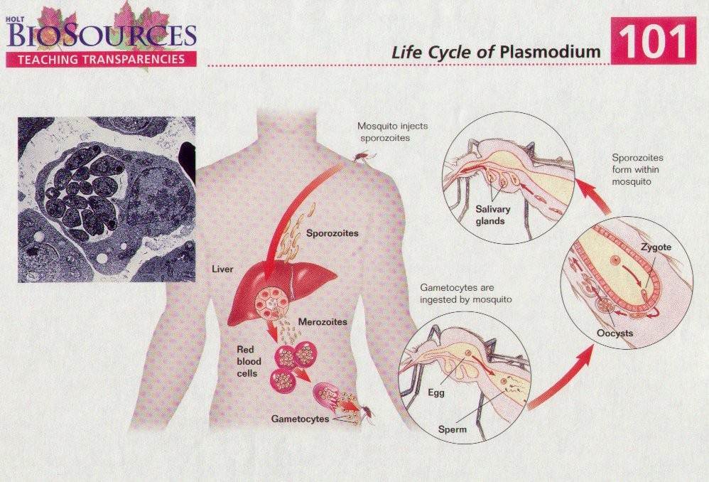

Slide 17
Plant-like protists are algae.
Algae are eukaryotic autotrophs.
They, along with other eukaryotic autotrophs, form the foundation of Earth’s food chains.
They produce much of Earth’s oxygen.

Slide 18
There are three unicellular phyla of algae:
Phylum Euglenophyta
Phylum Bacillariophyta
Phylum Dinoflagellata

Slide 19
Members of first phylum of algae, Euglenophyta, are both plant-like and animal-like.
Euglena are autotrophs since they make food from sunlight and
Heterotrophs since they ingest food from surrounding water.

Slide 20
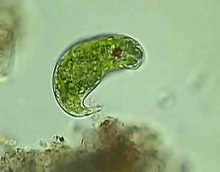

Slide 21
The second unicellular algae, Bacillariophyta, are photosynthetic autotrophs.
They have shells of silica.
They make up a large portion of the world’s phytoplankton which is Earth’s largest provider of oxygen.

Slide 22
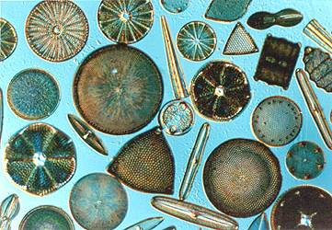
DIATOMS

Slide 23
The third unicellular algae, Dinoflagellata, are a major component of marine phytoplankton.
These algae have at least two flagella set at right angles to each other and thick cell walls made of cellulose plates.
Blooms of dinoflagellates cause “Red Tide.”

Slide 24
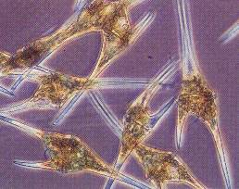

Slide 25
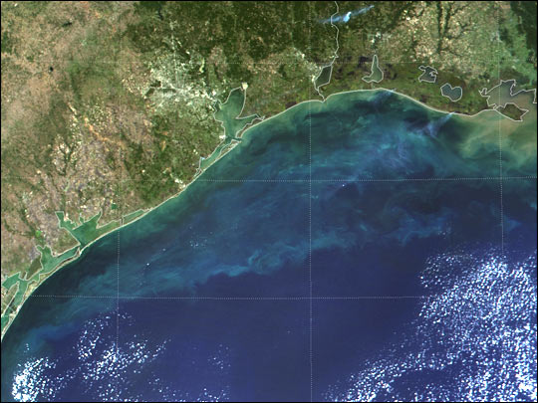

Slide 26
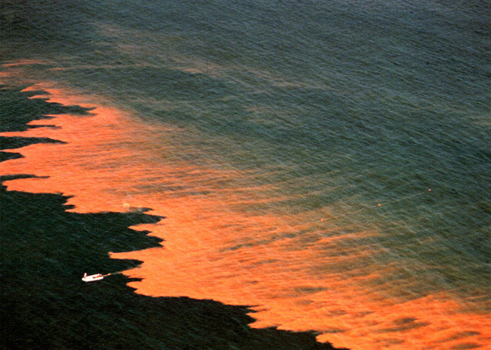

Slide 27
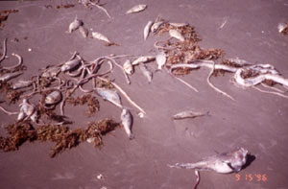

Slide 28
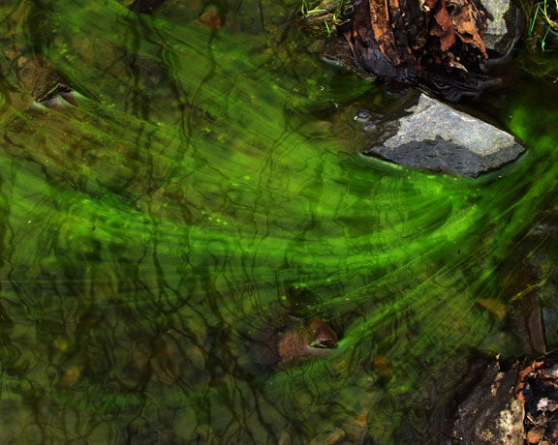
Multicellular algae are classified by color.

Slide 29
Rhodophyta are red seaweeds.
They are found in warm or cold marine environments along coast lines in deeper water.
They absorb green, violet, and blue light waves. These light waves are able to penetrate below 100 meters.

Slide 30
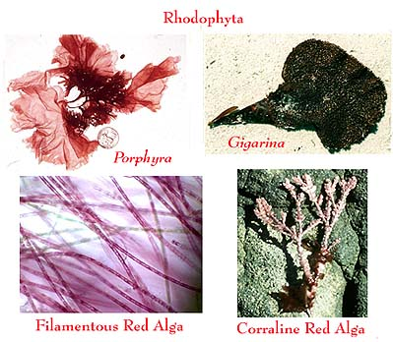

Slide 31
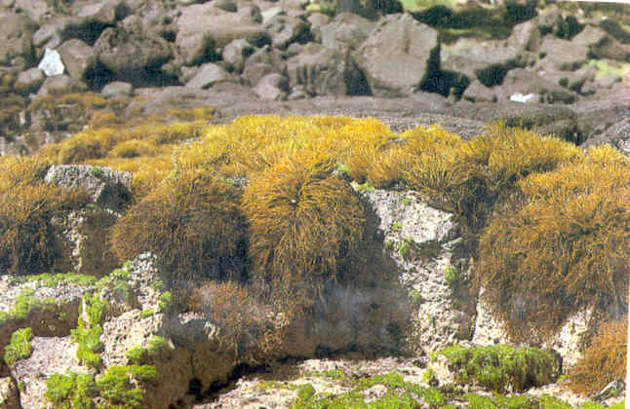
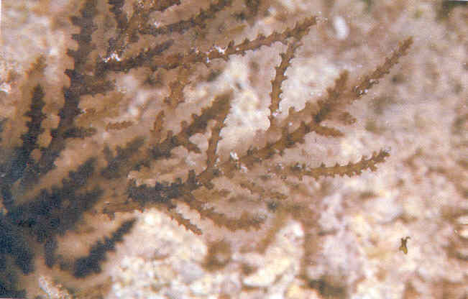
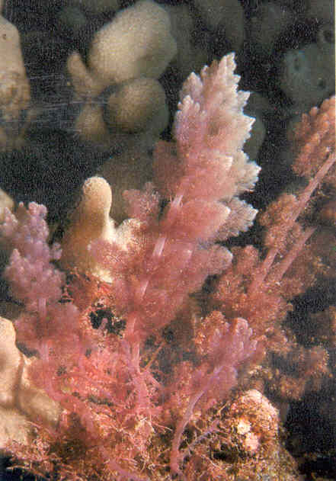
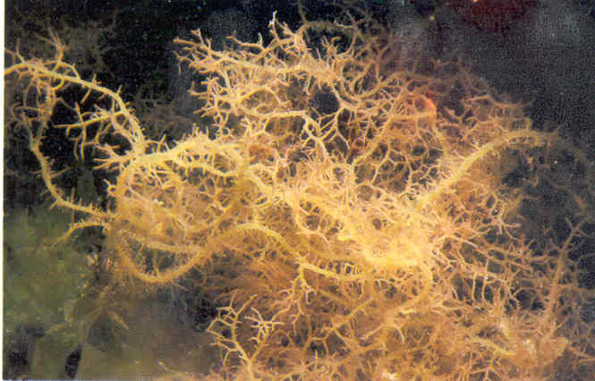
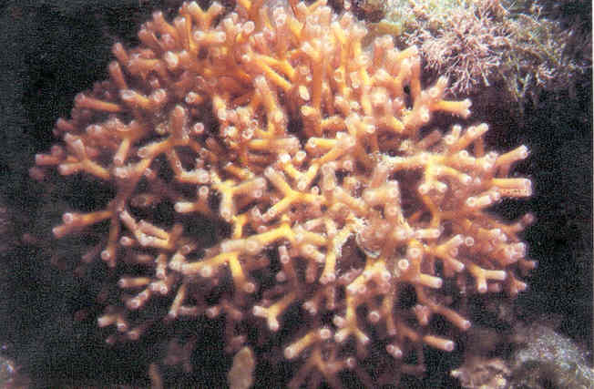
Rhodophyta: Red Algae
Ahnfeltia concinna
Acanthophora spicifera
Hypnea chordacea
Asparagopsis taxiformis
Galaxaura fastigiata

Slide 32
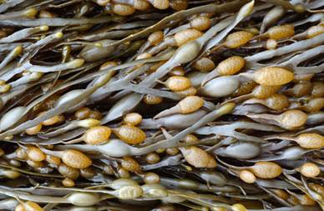
Phylum Phaeophyta is made up of the brown algae.
They are found in cool saltwater along rocky coasts.
Giant Kelp are the largest and most complex brown algae. They have hold fasts and air bladders.

Slide 33
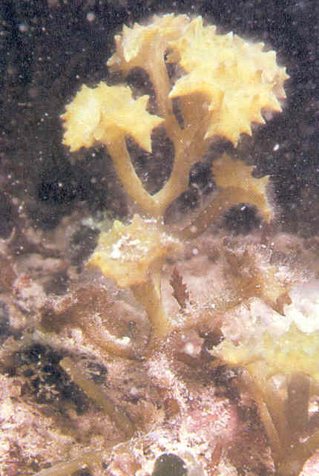
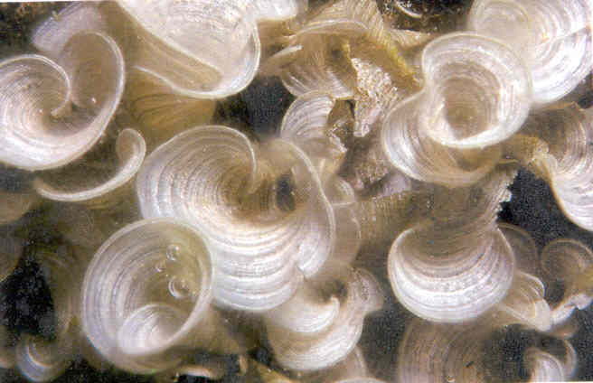
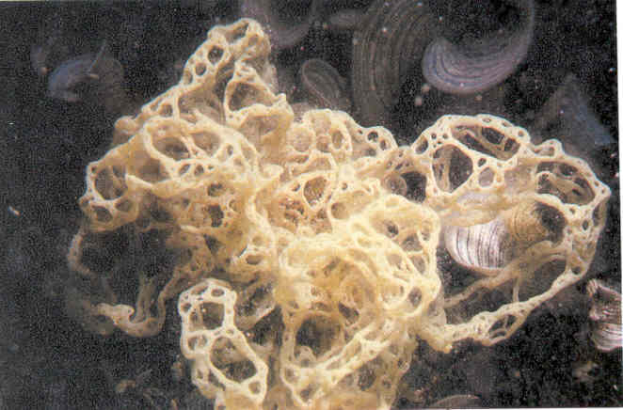
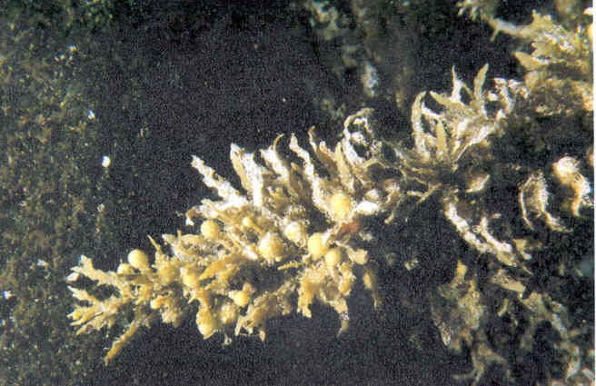
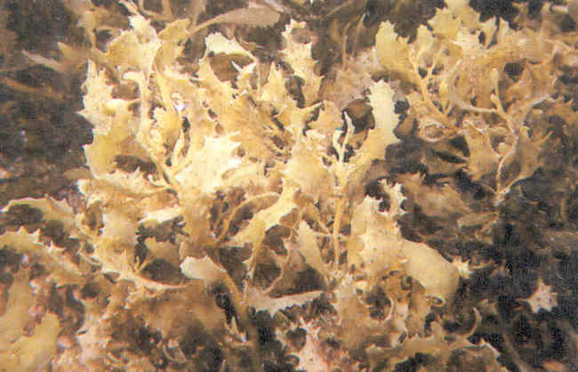
Phaeophyta: Brown Algae
Turbinaria ornata
Padina japonica
Hydroclathrus clathratus
Sargassum polyphyllum
Sargassum echinocarpum

Slide 34
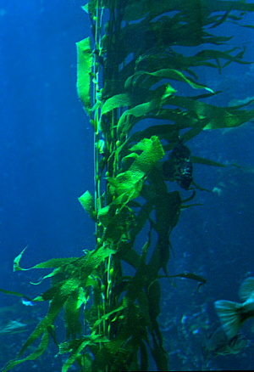
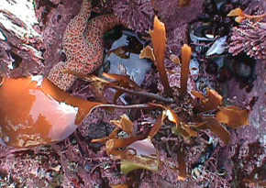

Slide 35
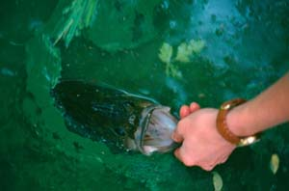
The last of the multicellular algae are the green algae from the Phylum chlorophyta.
Most green algae are found in fresh water habitats.

Slide 36
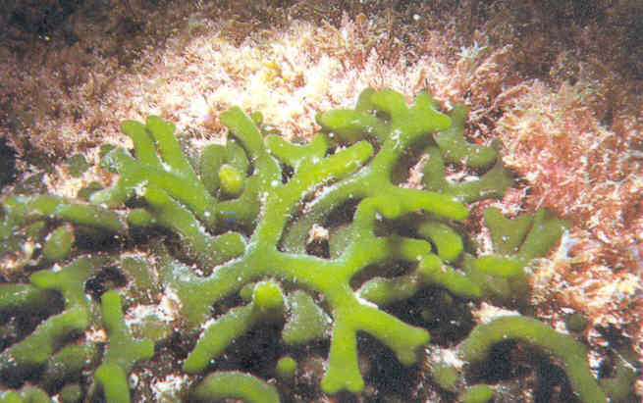
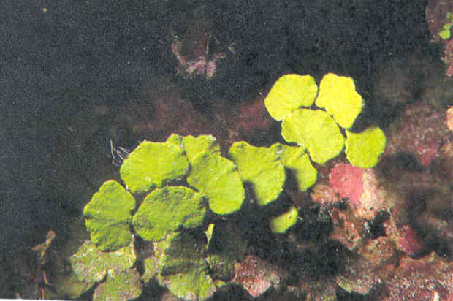
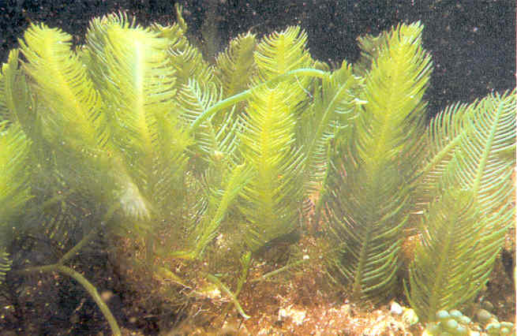
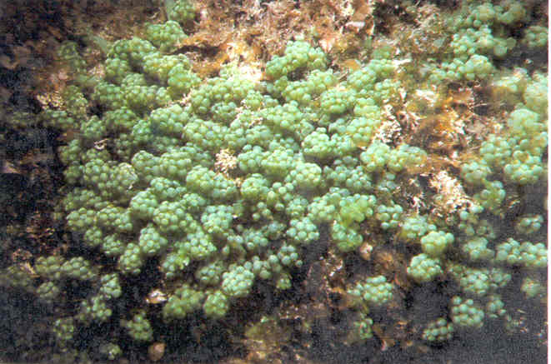
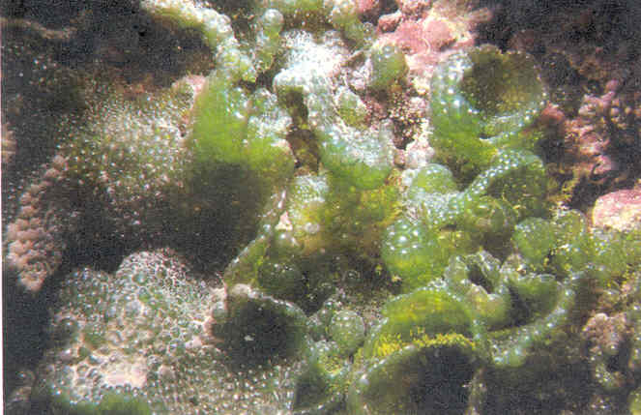
Chlorophyta: Green Algae
Halimeda opuntia
Codium edule
Caulerpa sertularioides
Dictyosphaeria cavernosa
Caulerpa racemosa

Slide 37
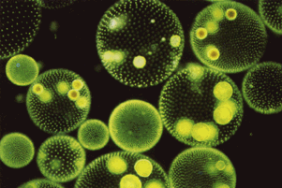
A Volvox is a hollow boll composed of hundreds of flagellated cells in a single layer.

Slide 38
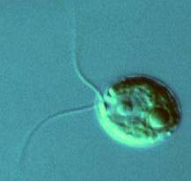
Chlamydomonas are actually unicellular and flagellated.

Slide 39
Fungus-like protists, Myxomycota and Oomycota are decomposers.
Phylum Myxomycota are made up of plasmodial slime molds.
Phylum Oomycota is made up of water molds and downy molds.

Slide 40
SlimeMolds Slime molds have traits like both fungi and animals. During good times, they live as independent, amoeba-like cells, dining on fungi and bacteria. But if conditions become uncomfortable—not enough food available, the temperature isn't right, etc.—individual cells begin gathering together to form a single structure. The new communal structure produces a slimy covering and is called a slug because it so closely resembles the animal you sometimes see gliding across sidewalks. The slug oozes toward light. When the communal cells sense that they've come across more food or better conditions, the slug stops

Slide 41
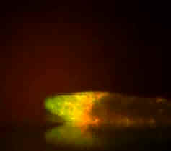
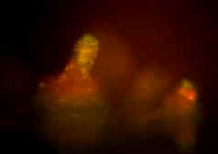

Slide 42
Water molds from the Phylum Oomycota are classified as protists because they have flagellated reproductive cells.
Downy mildews parasitize plants and are decomposers in freshwater ecosystems.

Slide 43
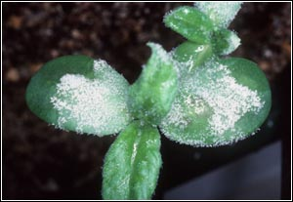
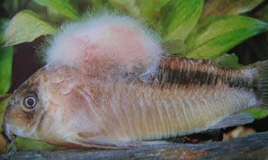

Slide 44
